Slide 1

Staff Scheduling Application Workforce..
Praneswar G – 727822TUCS140 SabeesJoshua a – 727822TUCS159
RithishKumar N – 727822TUCS155
Ram Prasad – 727822TUCS148

Slide 2
Agenda
1
2
3
4
5
Introduction
Use Cases
Components
BACKEND
Summary

Slide 3

Introduction
A Staff Scheduling Application built using Spring Boot is a powerful and comprehensive solution designed to address the complexities of managing and optimizing staff schedules in various industries, including retail, healthcare, and hospitality. In today's fast-paced and dynamic work environments, efficient scheduling is crucial for ensuring that the right number of staff with the appropriate skills are available at the right times. This application allows administrators and managers to create, manage, and optimize staff schedules with ease.

Slide 4

Use Cases

Slide 5
Use cases:
User Authentication and Authorization: Employee Management: Shift Creation and Management: Scheduling Algorithm: Time-Off Requests: Shift Swapping: Notifications and Reminders: Reporting and Analytics: User-Friendly Interface: Integration with Calendar Apps: Scalability and Performance:

Slide 6
Advantages
Centralized Overview:
Consolidates key metrics into a single view, allowing the Product Manager to quickly assess the status of teams and projects.
Data Visualization:
Utilizes Pie Charts to visually represent statistics, making it easier to interpret complex data at a glance.
Enhanced Decision Making:
Provides real-time data that supports informed decision-making, improving overall project management efficiency.
User-Friendly Interface:
Designed with Material-UI for a modern and responsive interface that is intuitive and easy to navigate.
Customizable and Extendable:
Built with React and Material-UI, allowing for easy customization and extension to meet specific needs and requirements.
Improved Productivity:
Reduces the time spent on gathering and interpreting data, allowing the Product Manager to focus on strategic tasks and improving team productivity.
Consistent Design:
Ensures a consistent look and feel across the application, enhancing user experience and reducing cognitive load.
Responsive Design:
Adapts to different screen sizes, making it accessible on various devices including desktops, tablets, and smartphones.

Slide 7
Components

Slide 8
Signup and Login Form
Based On the User Authentication and Authorization Use case we have the components Login and Signup form they get the data from the users from the signup form and Authenticate that data using the login form
Sample code:
<label>Email</label>
<TextField name='email' type='email' variant='outlined' value={form.email} onChange={handleChange} required />
<label>Password</label>
<TextField name='password' type='password' variant='outlined' value={form.password} onChange={handleChange} required />
<label>Role</label>
<TextField
name="role"
select
variant="outlined"
required
value={form.role}
onChange={handleChange}
>

Slide 9
Dashboard
We have the dashboards based on the each users Employee , Admin, Product Manager, TeamLeader based on each dashboard everything has unique features
Sample code:
import React from 'react';
import { Box, CssBaseline } from '@mui/material';
import { Routes, Route, Navigate } from 'react-router-dom';
import ProductManagerSidePanel from './ProductManagerSidePanel';
import Dashboard from './components/DashBoard';
import AssignEmployees from './components/AssignEmployees';
import ViewTeamLeadSchedule from './components/ViewTeamLeadSchedule';
import CreateProjects from './components/CreateProjects';
import Profile from './components/Profile';
const ProductManagerDashboard = () => {
return (
<Box sx={{ display: 'flex' }}>
<CssBaseline />
<ProductManagerSidePanel />
<Box component="main" sx={{ flexGrow: 1, p: 3 }}>
<Routes>
<Route path="/" element={<Navigate to="dashboard" />} />
<Route path="dashboard" element={<Dashboard />} />
<Route path="assign-employees" element={<AssignEmployees />} />
<Route path="view-team-lead-schedule" element={<ViewTeamLeadSchedule />} />
<Route path="create-projects" element={<CreateProjects />} />
<Route path="profile" element={<Profile />} />
</Routes>
</Box>
</Box>
);
};
export default ProductManagerDashboard;

Slide 10
Statistics
In the side panel we have the dashboard component we have the analytics section where the users can view the
Statistics in a visual and textual using MU-I and react recharts component
Sample code:
import React from 'react';
import ProductManagerSidePanel from '../ProductManagerSidePanel';
import { Box, Typography, Paper, Grid } from '@mui/material';
import { styled } from '@mui/system';
import { PieChart, Pie, Cell, ResponsiveContainer } from 'recharts';
const pieData = [
{ name: 'Teams', value: 8 },
{ name: 'Projects', value: 15 },
{ name: 'Completed Projects', value: 5 },
{ name: 'Employees Working', value: 50 },
];
const COLORS = ['#FF9999', '#66B2FF', '#99FF99', '#FFCC99'];
const StyledPaper = styled(Paper)({
padding: '16px',
borderRadius: '12px',
boxShadow: '0 4px 8px rgba(0, 0, 0, 0.1)',
});
const Dashboard = () => {
return (
<Box sx={{ display: 'flex' }}>
<ProductManagerSidePanel />
<Box sx={{ p: 3, flexGrow: 1 }}>
<Typography variant="h4" gutterBottom>Product Manager Dashboard</Typography>
<Grid container spacing={3}>
<Grid item xs={12} md={6}>
<StyledPaper>
<Typography variant="h6" gutterBottom>Statistics Overview</Typography>
<ResponsiveContainer width="100%" height={300}>
<PieChart>
<Pie data={pieData} dataKey="value" outerRadius={120} fill="#8884d8">
{pieData.map((entry, index) => (
<Cell key={`cell-${index}`} fill={COLORS[index % COLORS.length]} />
))}
</Pie>
</PieChart>
</ResponsiveContainer>
</StyledPaper>
</Grid>
<Grid item xs={12} md={6}>
<StyledPaper>
<Typography variant="h6" gutterBottom>Team Performance Stats</Typography>
<Typography variant="body1">Number of teams: 8</Typography>
<Typography variant="body1">Number of projects: 15</Typography>
<Typography variant="body1">Number of completed projects: 5</Typography>
<Typography variant="body1">Number of employees working on projects: 50</Typography>
</StyledPaper>
</Grid>
</Grid>
</Box>
</Box>
);
};
export default Dashboard;

Slide 11
SidePanel
For the Navigation in the dashboard we use the side panel so this side panel is updated based on the users and based on the assigned features so the users can navigate across the dashboard and able to navigate through the features of our dashboards
Sample code:
<List>
<ListItem button component={Link} to="/home">
<ListItemIcon><Home /></ListItemIcon>
<ListItemText primary="Home" />
</ListItem>
<ListItem button component={Link} to="/product-manager-dashboard">
<ListItemIcon><AutoAwesomeMosaicIcon /></ListItemIcon>
<ListItemText primary="Dashboard" />
</ListItem>
<ListItem button component={Link} to="/product-manager-dashboard/assign-employees">
<ListItemIcon><Assignment /></ListItemIcon>
<ListItemText primary="Assign Employees" />
</ListItem>
<ListItem button component={Link} to="/product-manager-dashboard/view-team-lead-schedule">
<ListItemIcon><Schedule /></ListItemIcon>
<ListItemText primary="View Team Lead Schedule" />
</ListItem>
<ListItem button component={Link} to="/product-manager-dashboard/create-projects">
<ListItemIcon><Create /></ListItemIcon>
<ListItemText primary="Create Projects" />
</ListItem>
<ListItem button component={Link} to="/product-manager-dashboard/profile">
<ListItemIcon><AccountCircle /></ListItemIcon>
<ListItemText primary="Profile" />
</ListItem>
</List>;

Slide 12
Profile
So if the users want to see their account details in case they want to change their account information in this profile section they can change . So the users can view, edit and update their details to the present
Sample code:
import React, { useState } from 'react';
import SidePanel from '../ProductManagerSidePanel';
import { TextField, Button, Grid, Card, CardContent } from '@mui/material';
const Profile = () => {
const [profile, setProfile] = useState({
name: 'ProductManager',
email: 'productmanager@example.com',
role: 'ProductManager',
});
const handleChange = (e) => {
const { name, value } = e.target;
setProfile({ ...profile, [name]: value });
};
const handleSubmit = (e) => {
e.preventDefault();
// Handle profile update logic
console.log('Profile updated:', profile);
};
export default Profile;
return (
<div>
<SidePanel />
<h2>Profile</h2>
<Card>
<CardContent>
<form onSubmit={handleSubmit}>
<Grid container spacing={2} alignItems="center">
<Grid item xs={4}>
<TextField label="Name" name="name" variant="outlined" fullWidth value={profile.name} onChange={handleChange} />
</Grid>
<Grid item xs={4}>
<TextField label="Email" name="email" type="email" variant="outlined" fullWidth value={profile.email} onChange={handleChange} />
</Grid>
<Grid item xs={4}>
<TextField label="Role" name="role" variant="outlined" fullWidth value={profile.role} onChange={handleChange} />
</Grid>
<Grid item xs={12}>
<Button type="submit" variant="contained" color="primary">
Save
</Button>
</Grid>
</Grid>
</form>
</CardContent>
</Card>
</div>
);
};

Slide 13
Home Page
This home page component is serving a important functionality based on the user’s authentication based on the user type
It is help to navigate to the dashboard ‘s user’s type
Sample code:
const Home = ({ user, onLogout }) => {
const navigate = useNavigate();
const redirectToDashboard = () => {
if (user) {
switch (user.role) {
case 'admin':
navigate('/admin-dashboard');
break;
case 'employee':
navigate('/employee-dashboard');
break;
case 'hr':
navigate('/hr-dashboard');
break;
case 'team_lead':
navigate('/team-lead-dashboard');
break;
case 'product_manager':
navigate('/product-manager-dashboard');
break;
default:
navigate('/');
}
} else {
navigate('/login');
}
};
<div className="home-container">
<div className="hero-bg">
<Navbar />
<div className="hero">
<div className="hero-img">
<img src={illustration} alt="Illustration" />
</div>
<div className="hero-content">
<h1>Effortless Staff Scheduling with <b>WorkForce...</b></h1>
<div className="dashnavlol">
<Typography variant="h4">
Welcome {user ? user.role : 'Guest'}
</Typography>
{user ? (
<>
<Button variant="contained" color="secondary" onClick={redirectToDashboard} className='dashnavlolbutton'>
Dashboard
</Button><br></br>
<Button color="secondary" onClick={onLogout} className='logouthome'>
Logout
</Button>
</>
) : (
<Typography>
Please <a href="/login">login</a> to see your dashboard.
</Typography>
)}
</div>
</div>
</div>
</div>

Slide 14
Footer
The footer component is a functional component designed to provide footer content for the application. It utilizes Material – UI icons for the social media links and custom css styling
Sample code:
import React from 'react';
import { Facebook, Twitter, Instagram } from '@mui/icons-material';
import '../styles/Footer.css';
const Footer = () => {
return (
<div className="footer">
<div className="footer-container">
<div className="footer-section">
<h4>Company</h4>
<ul>
<li><a href="/about">About Us</a></li>
<li><a href="/services">Services</a></li>
<li><a href="/contact">Contact</a></li>
</ul>
</div>
<div className="footer-section">
<h4>Resources</h4>
<ul>
<li><a href="/blog">Blog</a></li>
<li><a href="/faq">FAQ</a></li>
<li><a href="/support">Support</a></li>
</ul>
</div>
<div className="footer-section">
<h4>Follow Us</h4>
<div className="social-icons">
<a href="https://facebook.com" target="_blank" rel="noopener noreferrer" aria-label="Facebook">
<Facebook />
</a>
<a href="https://twitter.com" target="_blank" rel="noopener noreferrer" aria-label="Twitter">
<Twitter />
</a>
<a href="https://instagram.com" target="_blank" rel="noopener noreferrer" aria-label="Instagram">
<Instagram />
</a>
</div>
</div>
</div>
<div className="footer-bottom">
<p>&copy; {new Date().getFullYear()} WorkForce. All rights reserved.</p>
</div>
</div>
);
};
export default Footer;

Slide 15
Navbar
The navbar component is a functional React component that provides a navigation bar for the application. It uses react-router-dom for navigation and custom CSS for styling
Sample code:
import React from 'react';
import { Link, useNavigate } from 'react-router-dom';
import '../styles/Navbar.css';
const Navbar = () => {
const navigate = useNavigate();
const handleNavigation = (path) => {
navigate(path);
};
return (
<div className='Navbar'>
<div className='nav-content'>
<div className='nav-left'>
<Link to="/" className='nav-title'>WorkForce</Link>
</div>
<div className='nav-right'>
<p className='nav-item' onClick={() => handleNavigation('/')}>Home</p>
<p className='nav-item' onClick={() => handleNavigation('/about')}>About</p>
<p className='nav-item' onClick={() => handleNavigation('/contact')}>Contact</p>
</div>
</div>
</div>
);
};
export default Navbar;

Slide 16
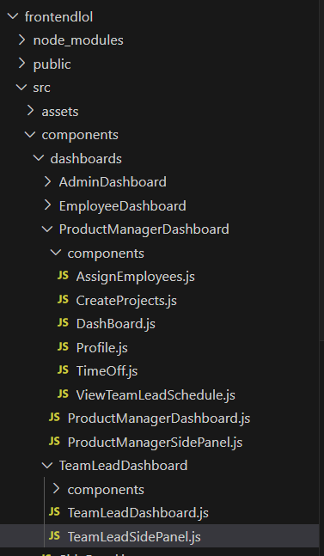
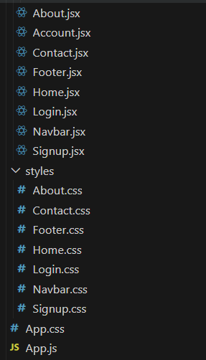

Slide 17
BACKEND

Slide 18
BACKEND
A Staff Scheduling Application built using Spring Boot is a powerful and comprehensive solution designed to address the complexities of managing and optimizing staff schedules in various industries, including retail, healthcare, and hospitality. In today's fast-paced and dynamic work environments, efficient scheduling is crucial for ensuring that the right number of staff with the appropriate skills are available at the right times. This application allows administrators and managers to create, manage, and optimize staff schedules with ease.

Slide 19
CONTROLLER
CONTROLLERS I HAVE USED:
AuthController.java
AdminController.java
ContactController.java
EmployeeScheduleController.java
EmployeeTaskController.java
ProductManagerController.java
ProjectController.java
TeamController.java
TeamLeadScheduleController.java
In Spring Boot, a controller is a crucial component of the MVC (Model-View-Controller) architecture. It handles HTTP requests, processes them, and returns a response. Controllers in Spring Boot are typically annotated with @RestController or @Controller, depending on whether you want to return data (usually in JSON format) or serve web pages (usually HTML).

Slide 20
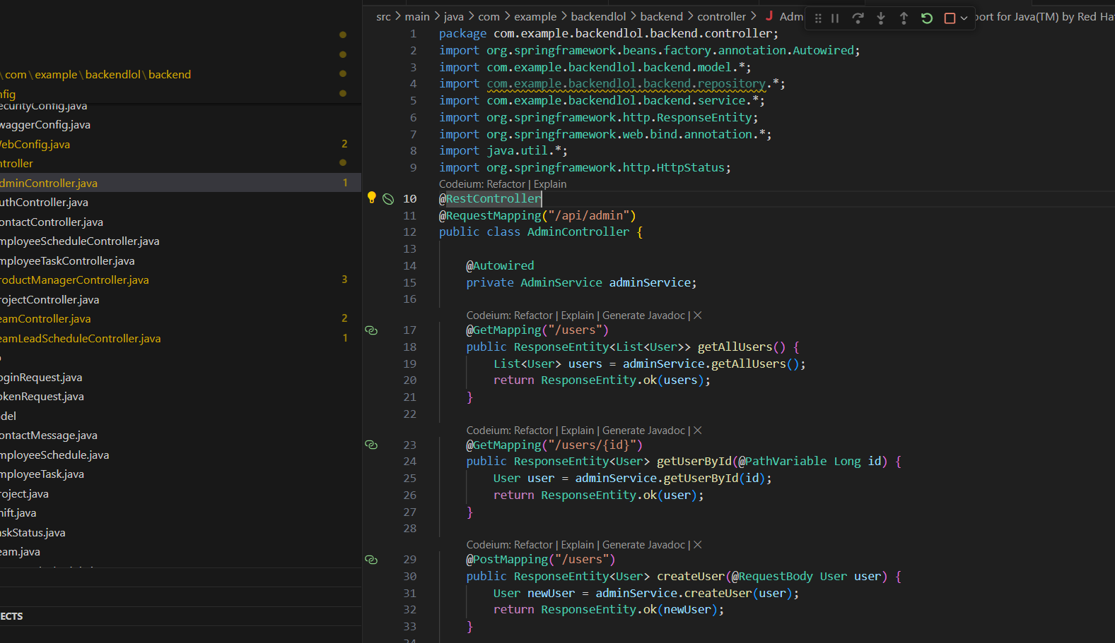
SAMPLE CODE:

Slide 21
MODEL
MODELS I HAVE USED:
ContactMessage.java
EmployeeSchedule.java
EmployeeTask.java
Project.java
Shift.java
TaskStatus.java
Team.java
TeamLeadSchedule.java
TimeOffRequest.java
User.java
In Spring Boot, the model represents the data structure of the application and the business logic that governs the manipulation of this data. Models are typically mapped to database tables in relational databases or can represent data structures in other storage systems. The model layer usually consists of entity classes, which define the attributes and behaviors of the data, and possibly service classes that implement business logic.

Slide 22
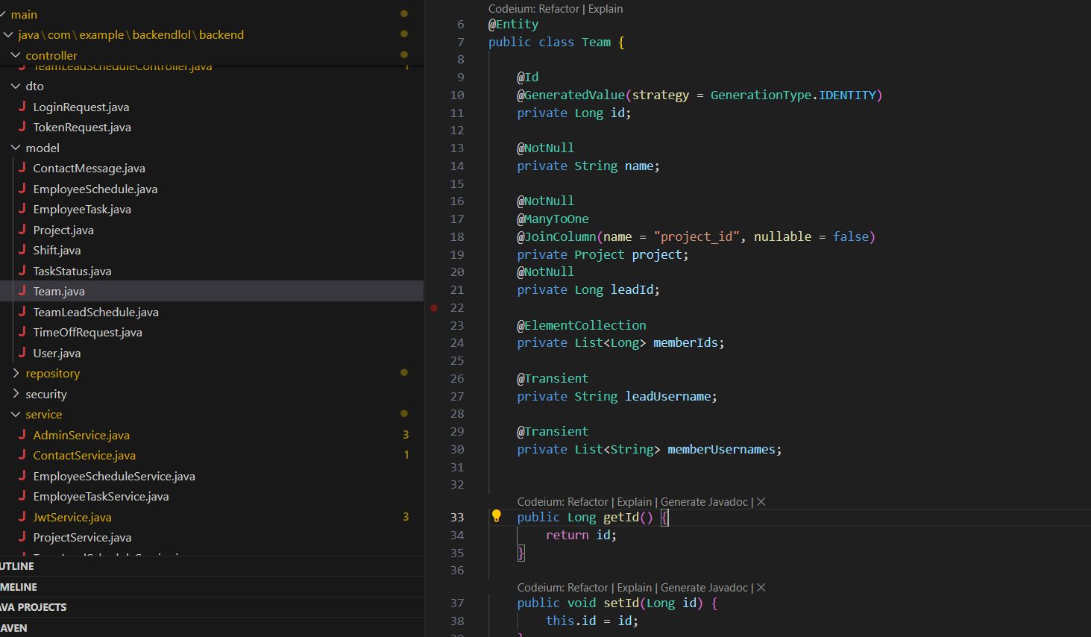
SAMPLE CODE:

Slide 23
REPOSITORY
REPOSITORIES I USED:
ContactMessageRepository.java
EmployeeScheduleRepository.java
EmployeeTaskRepository.java
ProjectRepository.java
TeamLeadScheduleRepository.java
TeamRepository.java
TimeOffRequestRepository.java
UserRepository.java
In Spring Boot, the repository is a key component of the data access layer. It is responsible for providing CRUD (Create, Read, Update, Delete) operations and other data-related operations on the application's data model. Spring Boot leverages Spring Data JPA (Java Persistence API) to simplify the implementation of data access layers, allowing developers to define repositories with minimal boilerplate code.

Slide 24
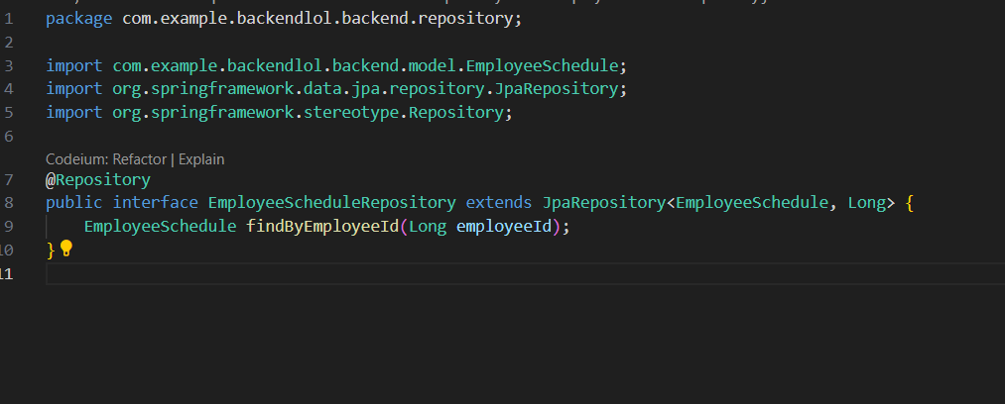
SAMPLE CODE:

Slide 25
SERVICE
SERVICE CLASSES I USED:
AdminService.java
ContactService.java
EmployeeScheduleService.java
EmployeeTaskService.java
JwtService.java
ProjectService.java
TeamLeadScheduleService.java
TeamService.java
UserService.java
In Spring Boot, the service layer is a crucial component of the application's architecture, responsible for encapsulating the business logic. This layer acts as an intermediary between the controller layer, which handles HTTP requests, and the repository layer, which interacts with the database. By isolating the business logic, the service layer ensures a clean separation of concerns, making the application more modular, maintainable, and testable.

Slide 26
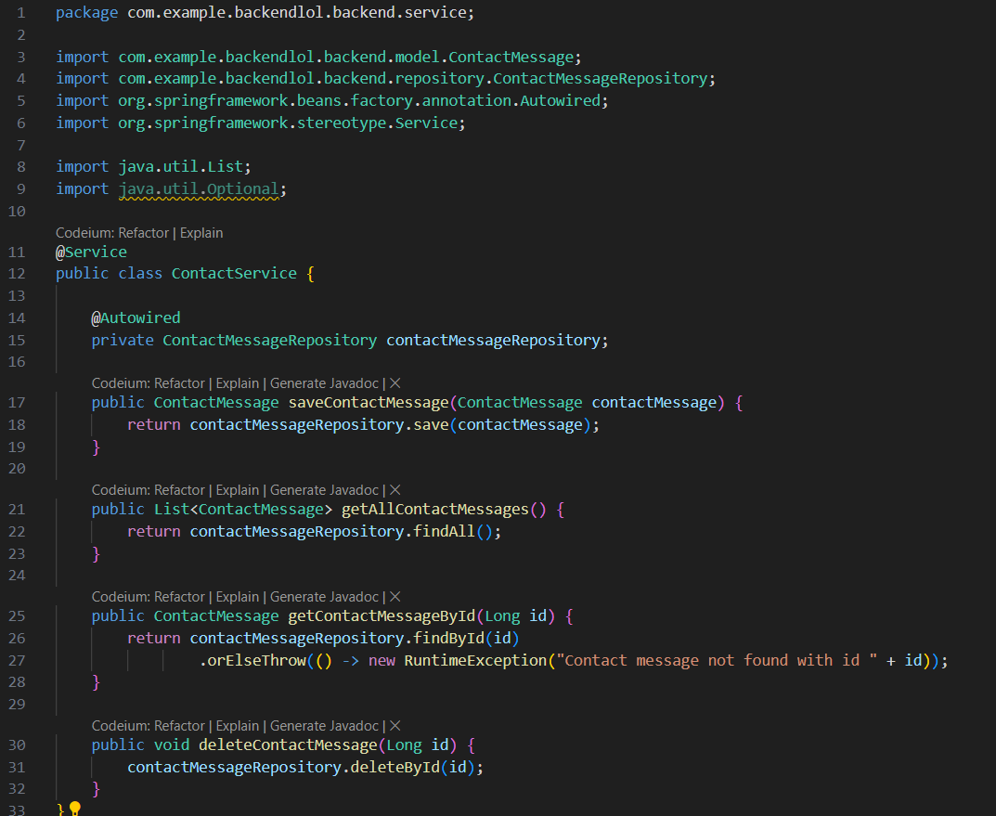
SAMPLE CODE:

Slide 27
SECRUITY
Spring Boot offers robust security features through Spring Security, providing comprehensive solutions for authentication, authorization, and protection against common security vulnerabilities. By integrating Spring Security, developers can easily implement secure login mechanisms, role-based access control, and secure password management.
It also offers protection against threats like CSRF, XSS, and session fixation. The framework's flexibility allows for the customization of security configurations, such as defining URL-based security rules, customizing login pages, and incorporating method-level security.

Slide 28
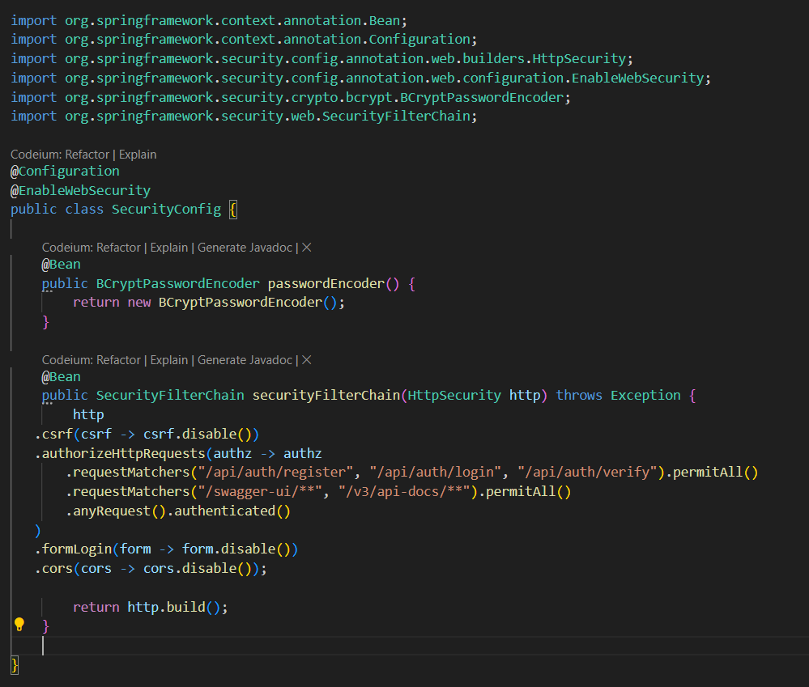
SAMPLE CODE:

Slide 29
OUTPUTS
“
”
Work Force …….

Slide 30
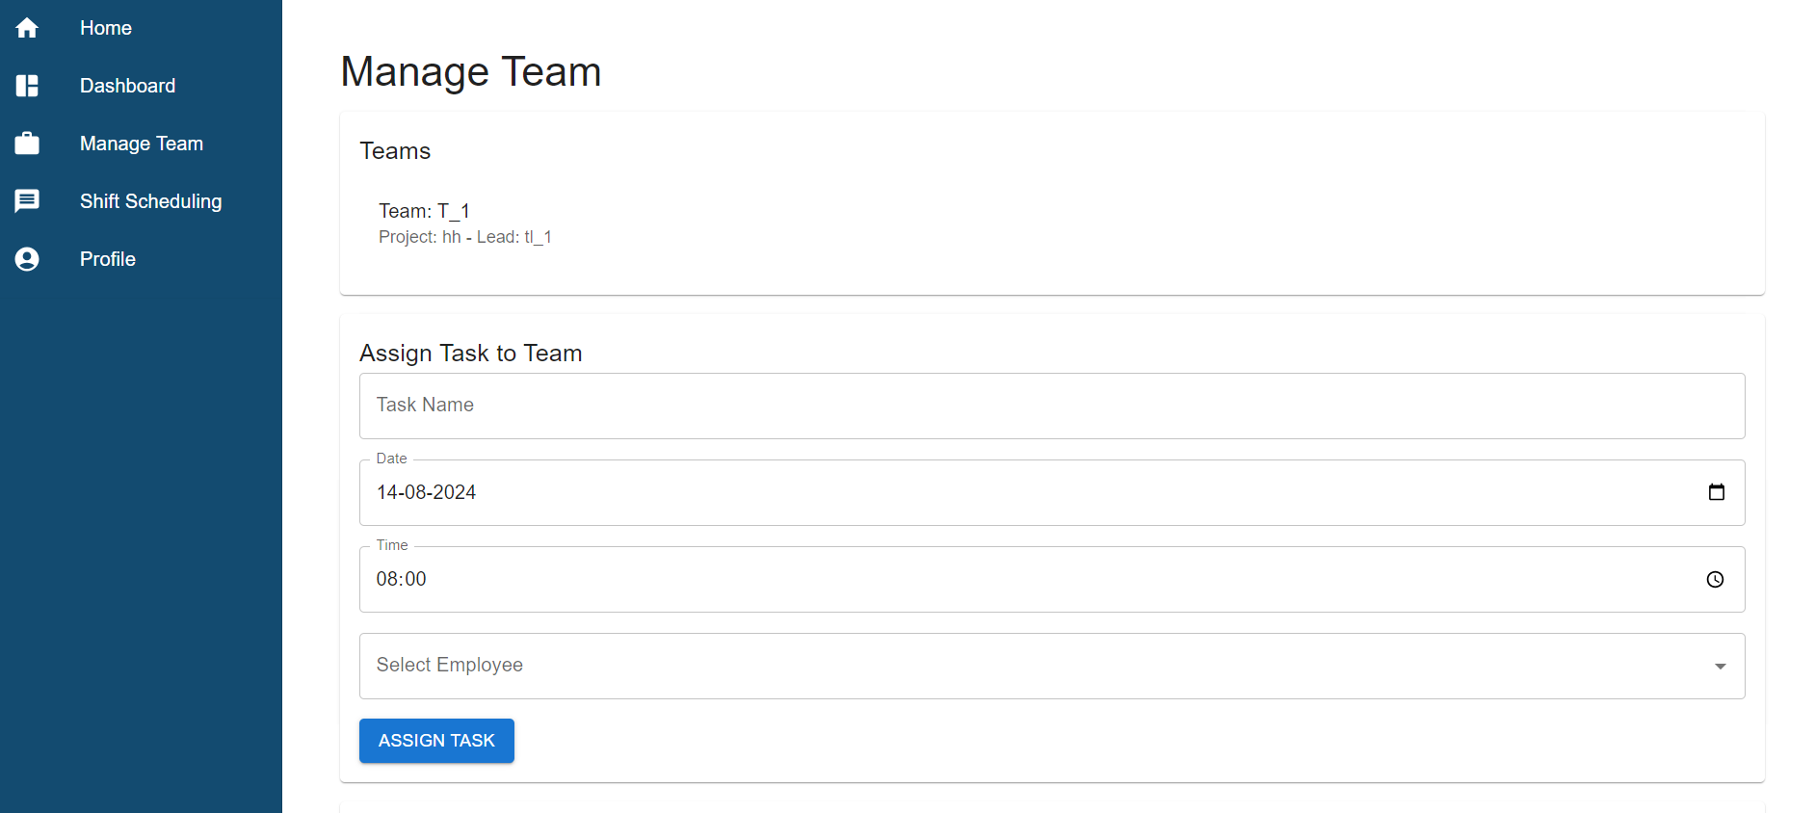
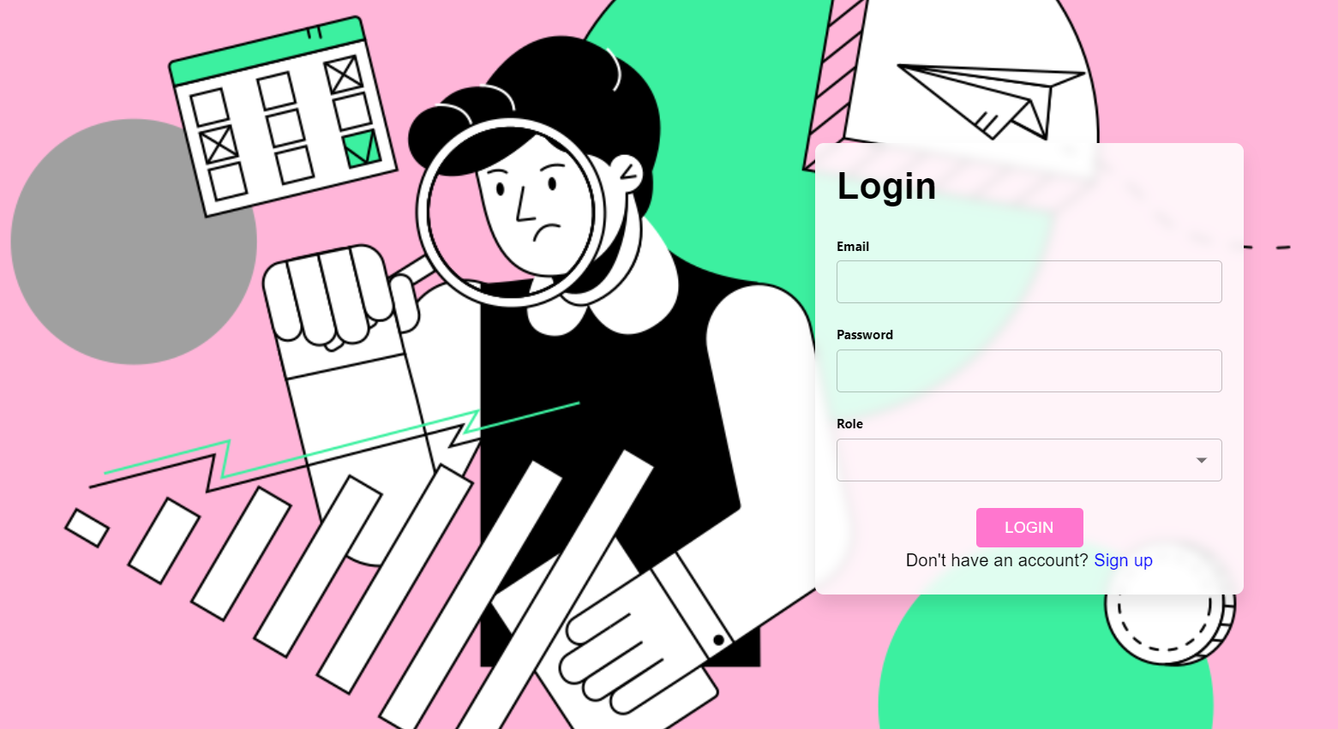
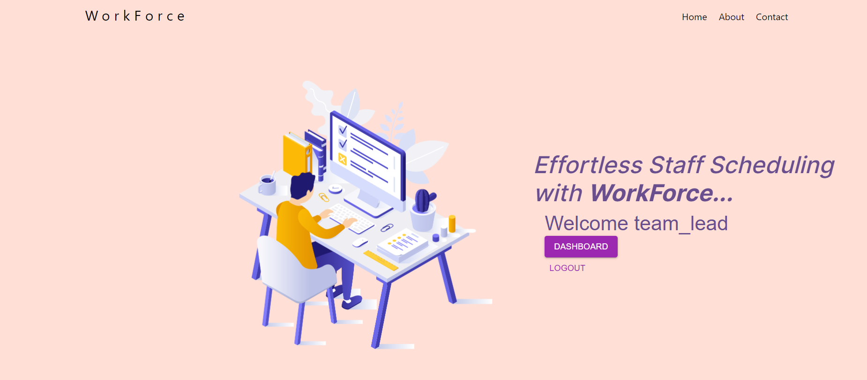
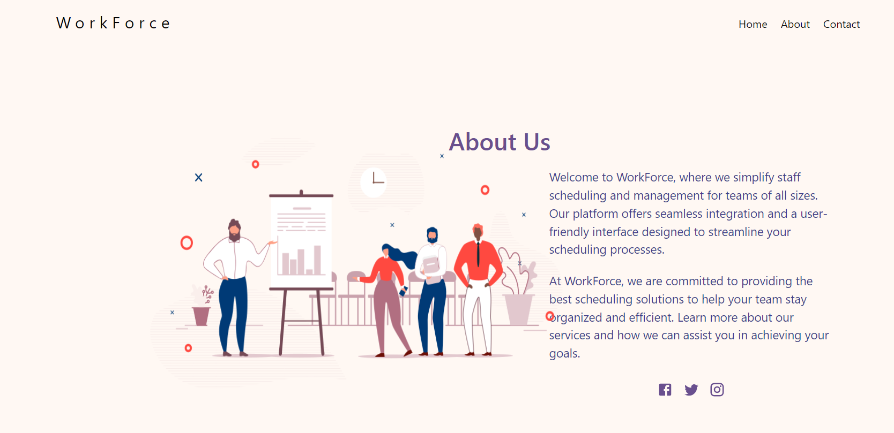

Slide 31
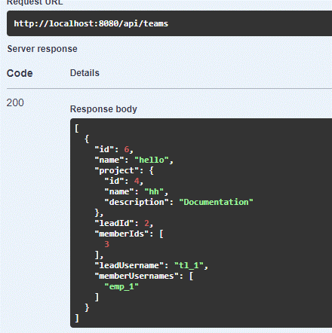
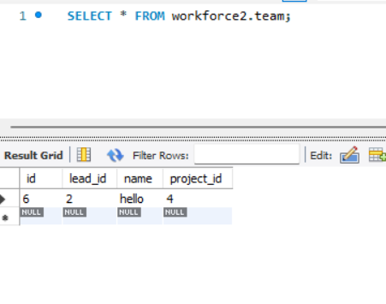
OUTPUTS:-

Slide 32
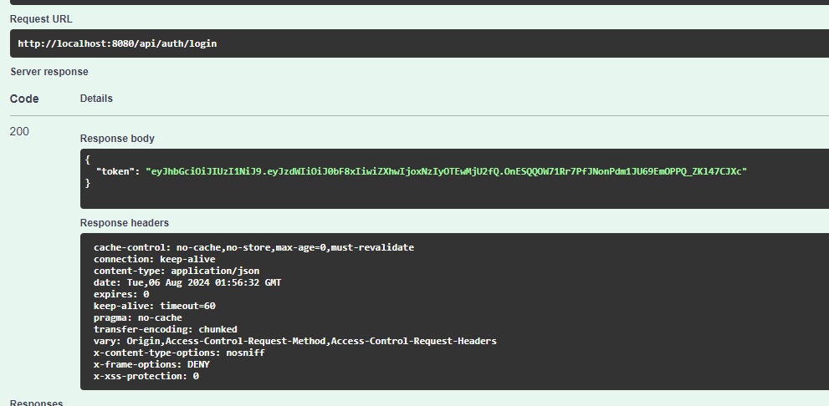
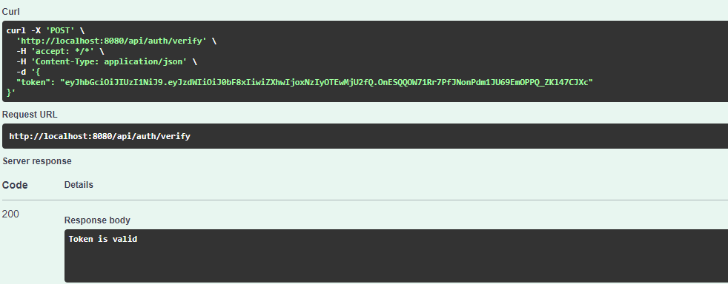
OUTPUTS:-

Slide 33
Summery
The Dashboard component is a powerful tool that centralizes key project and team metrics, provides real-time data visualization, and supports enhanced decision-making. Its user-friendly interface and customizable design make it an indispensable asset for effective product management and improved team productivity.
In conclusion, the Staff Scheduling Application effectively streamlines workforce management by combining React, Spring Boot, and MySQL to deliver a robust, user-friendly platform. It simplifies scheduling tasks for administrators and provides employees with intuitive tools for managing their shifts and time-off requests. The system’s real-time notifications, comprehensive reporting, and scalable architecture ensure that it meets the evolving needs of both staff and management, fostering improved efficiency and communication within the organization.

Slide 34
Thank you

